Slide 1

PRESENTATION
OF
BANK MANAGEMENT SYSTEM

Slide 2

Aim
WELLCOME TO MY PROJECT
The bank management system is an application for maintaining a person’s account in a bank .
The system provides the access to the customer to create an account, deposit/withdraw the cash from his account, also to view reports of all accounts present
The following presentation provides the specification for the system.

Slide 3

NAME:MAHMUDUL HASAN
ID:2014-2-60-035

Slide 4

Aim
PROJECT
The bank management system is an application for maintaining a person’s account in a bank .
The system provides the access to the customer to create an account, deposit/withdraw the cash from his account, also to view reports of all accounts present
The following presentation provides the specification for the system.
BANKING MANAGEMENT
SYSTEM

Slide 5
Aim
CASE STUDY
The bank management system is an application for maintaining a person’s account in a bank .
The system provides the access to the customer to create an account, deposit/withdraw the cash from his account, also to view reports of all accounts present
The following presentation provides the specification for the system.
This project is designed & developed in code Block.
This project will facilitate the bank authority in bank to keep record of Members and view record of the member and store all record.
So the authority can easily check all data.
We can also erase data and modify data of all the customer.
So that all the system is easy to access.
We can save many time by using this project.

Slide 6
Aim
DIAGRAMRE
The bank management system is an application for maintaining a person’s account in a bank .
The system provides the access to the customer to create an account, deposit/withdraw the cash from his account, also to view reports of all accounts present
The following presentation provides the specification for the system.
Bank management system
Login PASSWORD
If correct password
Wrong password.
Back to login
Or exit
MAIN MENU
WELLCOME BANK MANAGEMENT SYSTEM
MY CHOICE

Slide 7

Aim
1.CREATE ACCOUNT:
A.YOUR ACCOUNT NAME:
B.YOUR ACCOUNT NUMBER:
C.YOU WANT TO DEPOSIT:
D.PHONE NUMBER ::::::::::
E.ADDRESS::::::::::::::::::::::::
2.UPDATE INFORMATION:
a.PHONE NUMBER
b.ADDRESS
3.FOR TRANSATION
ACCOUNT NUMBER
HOW MUCH MONEY TRANSIT
4.CHEAK DETAILS:
View details
5.Removing account
Enter your number
6.view customer list::::::::::::::::
Details about customer .
Exit:
End of the programme
The bank management system is an application for maintaining a person’s account in a bank .
The system provides the access to the customer to create an account, deposit/withdraw the cash from his account, also to view reports of all accounts present
The following presentation provides the specification for the system.

Slide 8
Aim
:: Module Description ::
The bank management system is an application for maintaining a person’s account in a bank .
The system provides the access to the customer to create an account, deposit/withdraw the cash from his account, also to view reports of all accounts present
The following presentation provides the specification for the system.
New customer | Provides options to deposit amount from the given account
Update information customer | changing options to amount from the given account number
For transaction | Add money

Slide 9
Aim
:: Module Description ::
MODULE | DESCRIPTION
Cheak detail abount customer | Cheak all details about those account
Remove account | Remove all information folling account
View account | View Details about account
Exit | Exit the programme
The bank management system is an application for maintaining a person’s account in a bank .
The system provides the access to the customer to create an account, deposit/withdraw the cash from his account, also to view reports of all accounts present
The following presentation provides the specification for the system.

Slide 10
Aim
In This Programme Using:
Library function:
stdio.h
Math.h
String.h
Main function:
Structure
Swich case
Goto
String
File handilling
function
The bank management system is an application for maintaining a person’s account in a bank .
The system provides the access to the customer to create an account, deposit/withdraw the cash from his account, also to view reports of all accounts present
The following presentation provides the specification for the system.

Slide 11
Aim
:: CONCLUSION ::
The bank management system is an application for maintaining a person’s account in a bank .
The system provides the access to the customer to create an account, deposit/withdraw the cash from his account, also to view reports of all accounts present
The following presentation provides the specification for the system.
This project is developed to nurture the needs of a user in a banking sector by embedding all the tasks of transactions taking place in a bank.
Future version of this software will still be much enhanced than the current version .Thus the Bank Management System it is developed and executed successfully.

Slide 12
Aim
The bank management system is an application for maintaining a person’s account in a bank .
The system provides the access to the customer to create an account, deposit/withdraw the cash from his account, also to view reports of all accounts present
The following presentation provides the specification for the system.
OUTPUT

Slide 13
Aim
The bank management system is an application for maintaining a person’s account in a bank .
The system provides the access to the customer to create an account, deposit/withdraw the cash from his account, also to view reports of all accounts present
The following presentation provides the specification for the system.
SNAPSHOTS

Slide 14
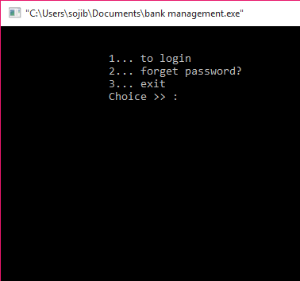
Aim
The bank management system is an application for maintaining a person’s account in a bank .
The system provides the access to the customer to create an account, deposit/withdraw the cash from his account, also to view reports of all accounts present
The following presentation provides the specification for the system.

Slide 15
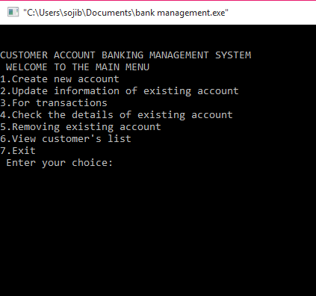
Aim
The bank management system is an application for maintaining a person’s account in a bank .
The system provides the access to the customer to create an account, deposit/withdraw the cash from his account, also to view reports of all accounts present
The following presentation provides the specification for the system.

Slide 16
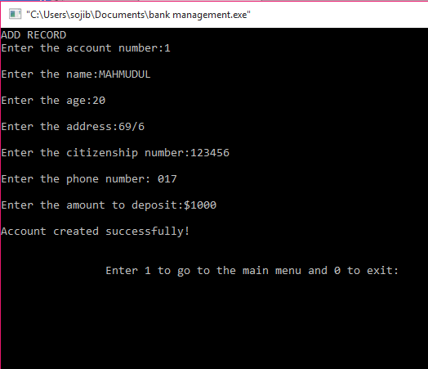

Slide 17
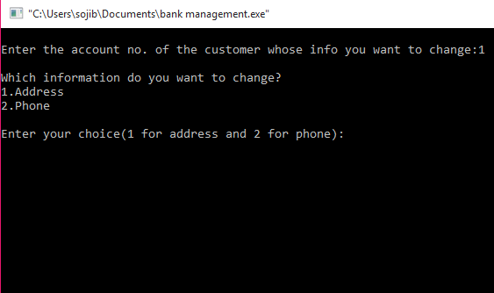

Slide 18
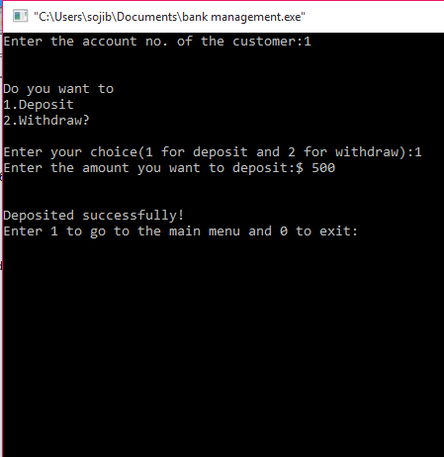

Slide 19
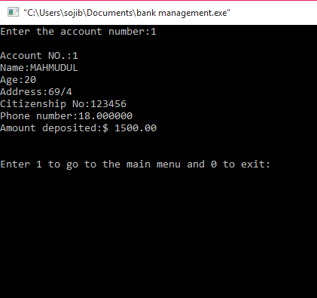

Slide 20

Aim
The bank management system is an application for maintaining a person’s account in a bank .
The system provides the access to the customer to create an account, deposit/withdraw the cash from his account, also to view reports of all accounts present
The following presentation provides the specification for the system.

Slide 21

Aim
The bank management system is an application for maintaining a person’s account in a bank .
The system provides the access to the customer to create an account, deposit/withdraw the cash from his account, also to view reports of all accounts present
The following presentation provides the specification for the system.

